Slide 1
Chapter 2
Finite Automata

Slide 2
Extended delta transitions (δ)
0
0,1
symbols
0
0
1
start
q₀
q₁
q₂
q₀
q₀
q₁
1
1
states
q₁
q₀
q₂
*q₂
q₂
q₂
A transition functions:
δ(q_{0,} 0) =q₀
δ(q_{0,} 1) =q₁
δ(q_{1,} 0) =q₀
δ(q_{1,} 1) =q₂
δ(q_{2,} 0) =q₂
δ(q_{2,} 1) =q₂
What is the destination state from state q on case of input string w
Input is a symbol
0 or 1
δ(q_{0,} 11) =??

Slide 3
Extension of transitions (δ) to Paths (δ)
δ (q,w) = destination state from state q on input string w
δ (q,wa) = δ (δ(q,w), a)
Work out the following example using the input sequence w=1001, a=1:
δ (q₀,wa) = ?

Slide 4
Example: Extended Delta
0
1
B A A
C A B
C C C
˄
˄
δ(B, 100101) = δ(δ(B,10010),1)
= δ(δ(δ(B,1001),0),1)
=δ(δ(δ(δ(B,100),1),0),1)
=δ(δ(δ(δ(δ(B,10),0),1),0),1)
=δ(δ(δ(δ(δ(δ(B,1),0),0),1),0),1)
=δ(δ(δ(δ(δ(C,0),0),1),0),1)
=δ(δ(δ(δ(C,0),1),0),1)
= δ(δ(δ(C,1),0),1)
= δ(δ(C,0),1) = δ(C,1) = C
˄
˄
˄

Slide 5
Delta-hat
We don’t distinguish between the given delta and the extended delta or delta-hat.
The reason:
δ(q, a) = δ(δ(q, ε), a) = δ(q, a)
˄
˄
Extended deltas

Slide 6

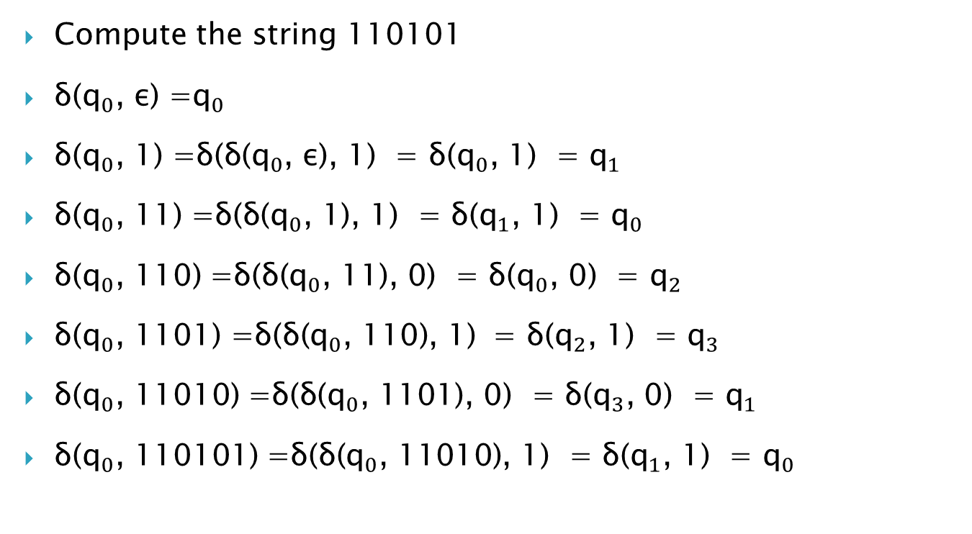
Example: Extended Delta
0
1
Compute the string 110101
δ(${\text{q}}_{0}$, ε) =${\text{q}}_{0}$
δ(${\text{q}}_{0}$, 1) =$\text{δ}\text{(}\text{δ}\text{(}{\text{q}}_{0}\text{, }\text{ε}\text{), }\text{1}\text{)}$ = δ(${\text{q}}_{0}$, 1) = ${\text{q}}_{1}$
δ(${\text{q}}_{0}$, 11) =$\text{δ}\text{(}\text{δ}\text{(}{\text{q}}_{0}\text{, }\text{1}\text{), }\text{1}\text{)}$ = δ(${\text{q}}_{1}$, 1) = ${\text{q}}_{0}$
δ(${\text{q}}_{0}$, 110) =$\text{δ}\text{(}\text{δ}\text{(}{\text{q}}_{0}\text{, }\text{11}\text{)}\text{, }\text{0}\text{)}$ = δ(${\text{q}}_{0}$, 0) = ${\text{q}}_{2}$
δ(${\text{q}}_{0}$, 1101) =$\text{δ}\text{(}\text{δ}\text{(}{\text{q}}_{0}\text{, }\text{110}\text{)}\text{, }\text{1}\text{)}$ = δ(${\text{q}}_{2}$, 1) = ${\text{q}}_{3}$
δ(${\text{q}}_{0}$, 11010) =$\text{δ}\text{(}\text{δ}\text{(}{\text{q}}_{0}\text{, }\text{1101}\text{)}\text{, }\text{0}\text{)}$ = δ(${\text{q}}_{3}$, 0) = ${\text{q}}_{1}$
δ(${\text{q}}_{0}$, 110101) =$\text{δ}\text{(}\text{δ}\text{(}{\text{q}}_{0}\text{, }\text{11010}\text{)}\text{, }\text{1}\text{)}$ = δ(${\text{q}}_{1}$, 1) = ${\text{q}}_{0}$
${\text{q}}_{1}$ ${\text{q}}_{2}$ ${\text{q}}_{0}$
${\text{q}}_{0}$ ${\text{q}}_{3}$ ${\text{q}}_{1}$
${\text{q}}_{3}$ ${\text{q}}_{0}$ ${\text{q}}_{2}$
${\text{q}}_{2}$ ${\text{q}}_{1}$ ${\text{q}}_{3}$
˄
˄
˄
˄
˄
˄
˄
˄
˄
˄
˄
˄
˄

Slide 7
Non-deterministic Finite Automata (NFA)
A Non-deterministic Finite Automaton (NFA)
Implying that the machine can exist in more than one state at the same time
Transitions could be non-deterministic
1
q_{j}
q_{i}
…
Each transition function therefore maps to a set of states
1
q_{k}

Slide 8
Non-deterministic Finite Automata (NFA)
A Non-deterministic Finite Automaton (NFA) consists of:
Q ==> a finite set of states
∑ ==> a finite set of input symbols (alphabet)
q₀ ==> a start state
F ==> set of accepting states
δ ==> a transition function, which is a mapping between Q x ∑ ==> subset of Q
An NFA is also defined by the 5-tuple:
{Q, ∑ , q₀,F, δ }

Slide 9
How to use an NFA?
Input: a word w in ∑*
Question: Is w acceptable by the NFA?
Steps:
Start at the “start state” q₀
For every input symbol in the sequence w do
Determine all possible next states from all current states, given the current input symbol in w and the transition function
If after all symbols in w are consumed and if at least one of the current states is a final state then accept w;
Otherwise, reject w.

Slide 10
NFA for strings end in 01
Why is this non-deterministic?
0,1
start
q₀
0
q₁
1
q₂
Final state
The states an NFA is in during the processing Of input sequence 00101
q₀
0
0
1
0
1
q₀
q₀
q₀
q₀
q₀
0
0
0
q₁
q₁
q₁
0
stuck
1
1
q₂
q₂
stuck
0
0 0 1 0 1

Slide 11
NFA for strings end in 01
Q = {q₀,q₁,q₂}
Σ = {0,1}
start state = q₀
F = {q₂}
Transition table
symbols
0
1
q₀
{q₀,q₁}
{q₀}
states
q₁
Φ
{q₂}
*q₂
Φ
Φ

Slide 12
Non-deterministic Finite Automata (NFA)
The difference between DFA and NFA is in the type of δ
For NFA: δ takes a state and input symbol as argument and returns a set of zero, one or more states.
DFA: returning exactly one state

Slide 13
NFA for strings containing 01
Why is this non-deterministic?
Q = {q₀,q₁,q₂}
Σ = {0,1}
start state = q₀
F = {q₂}
Transition table
0,1
0,1
start
q₀
0
q₁
1
q₂
Final state
symbols
0
1
What will happen if at state q₁ an input of 0 is received?
q₀
{q₀,q₁}
{q₀}
states
q₁
Φ
{q₂}
*q₂
{q₂}
{q₂}

Slide 14
What is an “error state”?
Note: Omitting to explicitly show error states is just a matter of design convenience (one that is generally followed for NFAs), and i.e., this feature should not be confused with the notion of non-determinism.
A DFA for recognizing the key word “while”
An NFA for the same purpose:
w
h
i
l
e
q₀
q₁
q₂
q₃
q₄
q₅
Any other input symbol
q_{err}
Any symbol
w
h
i
l
e
q₀
q₁
q₂
q₃
q₄
q₅
Transitions into a dead state are implicit

Slide 15
Extension of δ to NFA Paths
Basis: δ (q,ε) = {q}
Induction:
Let δ (q₀,w) = {p₁,p₂…,p_{k}}
δ (p_{i},a) = S_{i} for i=1,2...,k
Then, δ (q₀,wa) = S₁ U S₂ U … U S_{k}

Slide 16
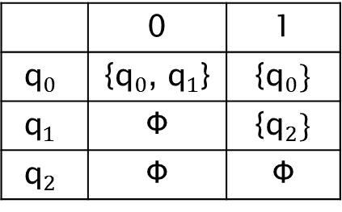
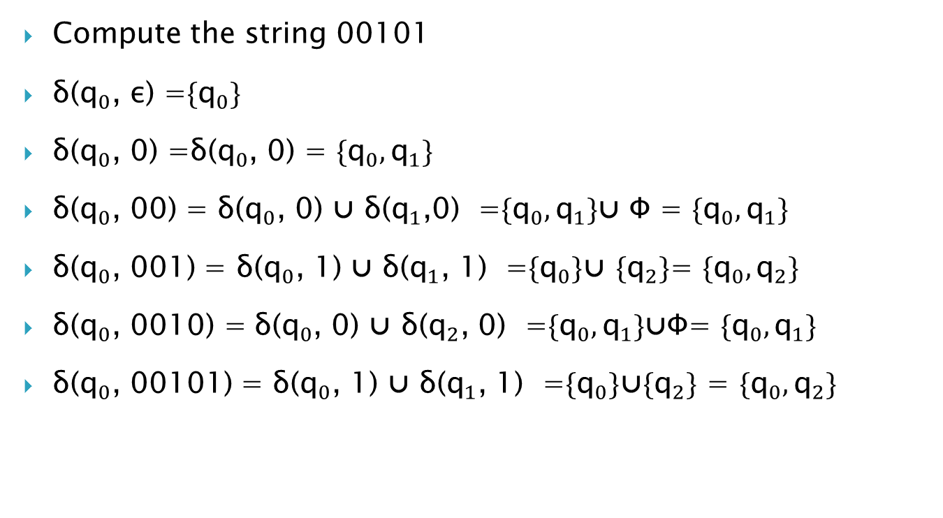
Example: Extended Delta
1 | 0
{${\text{q}}_{0}\}$ | {${\text{q}}_{0}$, ${\text{q}}_{1}$} | $${\text{q}}_{0}$$
{${\text{q}}_{2}\}$ | Φ | $${\text{q}}_{1}$$
Φ | Φ | $${\text{q}}_{2}$$
Compute the string 00101
δ(${\text{q}}_{0}$, ε) =${\text{\{}\text{q}}_{0}\}$
δ(${\text{q}}_{0}$, 0) =$\text{δ}\text{(}{\text{q}}_{0}\text{, }\text{0}\text{)}$ = ${\text{\{}\text{q}}_{0},{\text{q}}_{1}\}$
δ(${\text{q}}_{0}$, 00) = $\text{δ}\text{(}{\text{q}}_{0}\text{, }\text{0}\text{)}$ ⋃ δ(${\text{q}}_{1}$,0) =${\text{\{}\text{q}}_{0},{\text{q}}_{1}\}$⋃ Φ = ${\text{\{}\text{q}}_{0},{\text{q}}_{1}\}$
δ(${\text{q}}_{0}$, 001) = $\text{δ}\text{(}{\text{q}}_{0}\text{, }\text{1}\text{)}$ ⋃ δ(${\text{q}}_{1}$, 1) =${\text{\{}\text{q}}_{0}\}$⋃ ${\text{\{}\text{q}}_{2}\}$= ${\text{\{}\text{q}}_{0},{\text{q}}_{2}\}$
δ(${\text{q}}_{0}$, 0010) = $\text{δ}\text{(}{\text{q}}_{0}\text{, }\text{0}\text{)}$ ⋃ δ(${\text{q}}_{2}$, 0) =${\text{\{}\text{q}}_{0},{\text{q}}_{1}\}$⋃Φ= ${\text{\{}\text{q}}_{0},{\text{q}}_{1}\}$
δ(${\text{q}}_{0}$, 00101) = $\text{δ}\text{(}{\text{q}}_{0}\text{, }\text{1}\text{)}$ ⋃ δ(${\text{q}}_{1}$, 1) =${\text{\{}\text{q}}_{0}\}$⋃${\text{\{}\text{q}}_{2}\}$ = ${\text{\{}\text{q}}_{0},{\text{q}}_{2}\}$
˄
˄
˄
˄
˄
˄

Slide 17
Language of an NFA
An NFA accepts w if there exists at least one path from the start state to an accepting (or final) state that is labeled by w
L(N) = { w | δ(q₀,w) ∩ F ≠ Φ }

Slide 18
Examples #1
Build a NFA for the following language: L = { w | w is a binary string that contains 00 0r 11}
q₁
0
0,1
0,1
0
start
q₀
q₃
1
1
q₂

Slide 19
Examples #2
Build a NFA for the following language: L = { w | w is a binary string that ends with 101}
0,1
start
1
0
1
q₀
q₁
q₁
q₃

Slide 20
Examples #3
Build a NFA for the following language: L = { w | w is a binary string that the next-to-last symbol is 1}
0,1
start
q₀
1
q₁
0,1
q₂

Slide 21
Examples #3 DFA
Build a DFA for the following language: L = { w | w is a binary string that the next-to-last symbol is 1}
0
start
q₀
1
q₁
1
0
0
1
q₃
q₂
0
1

Slide 22
Advantages & Caveats for NFA
Great for modeling regular expressions
String processing - e.g., lexical analyzer
Could a non-deterministic state machine be implemented in practice?
Probabilistic models could be viewed as extensions of non-deterministic state machines (e.g., toss of a coin, a roll of dice)
They are not the same though
A parallel computer could exist in multiple “states” at the same time

Slide 23
DFAs and NFAs are equivalent in their power to capture languages !!
DFA
All transitions are deterministic
Each transition leads to exactly one state
For each state, transition on all possible symbols (alphabet) should be defined
NFA
Some transitions could be non-deterministic
A transition could lead to a subset of states
Not all symbol transitions need to be defined explicitly (if undefined will go to an error state – this is just a design convenience, not to be confused with “non-determinism”)

Slide 24
DFAs and NFAs are equivalent in their power to capture languages !!
DFA
Accepts input if the last state visited is in F
Sometimes harder to construct because of the number of states
Practical implementation is feasible
NFA
Accepts input if one of the last states is in F
Generally easier than a DFA to construct
Practical implementations limited but emerging (e.g., Micron automata processor)

